Slide 1
Digital Twins and Automated Manufacturing Systems: A Comprehensive Survey OF Emerging Industry 4.0 Technologies
Dan Blanchette

Slide 2
Introduction/Background
Paper Overview
The purpose of this research paper is to evaluate technologies(conceptual or implemented) that were introduced within the last 5 years(2018 – Present). As part of the analysis and discussion, I’m evaluating the plausibility of each implementation being viable to become an Industrial 4.0 standard for technology.
Topics I’ll Discuss:
Digital Twins implementations and Designs
AI Digital Twins: Holistic Factory Security.
Electric Car Design and Performance Testing Using a Digital Twin Model(Conceptual).
Industrial and Medical Automation Technologies
Nano Robotics and Automation in The Radiation Field.
Robotic Incremental Sheet Forming(aka: Robo-Forming)

Slide 3
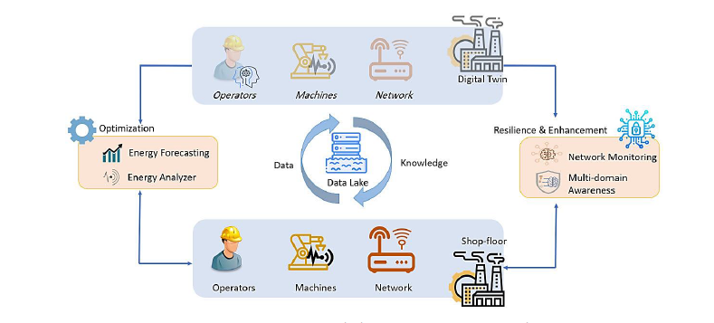

AI Digital Twins: Holistic Factory Security Using SMS-DT’s
The Pros:
The Cons:
Using the DT model of the factory setting on a small scale allows for many datapoints to be calculated using the simulated model.
ML and AI applications can be implemented thanks to the amount of data points
By utilizing facial recognition software for worker identification, and worker performance analysis, the DT can determine when workers are stressed or fatigued.
Captures attacks, vulnerabilities, and safety issues based on intelligent correlation of messages from multiple domains in an industrial cyber-physical environment[sic].
Most Factories to not utilize the same layout
Difficult to gather data on a macro scale from multiple factories to analyze trends.

Slide 4
Electric Car Design and Performance Testing Using a Digital Twin Model(Conceptual).
The Pros:
The Cons:
Being considered to aid auto manufacturers in electric car design.
Can be used to stress test electrical, sensor, and physical car components.
High return on investment to test in a virtual environment before committing to production on an automation line.
High startup costs.
DT’s models are limited by current hardware to model all aspects of reality such as physics or entropy.
The previous deficiencies makes it difficult to test all system outcomes(both positive and negative).

Slide 5
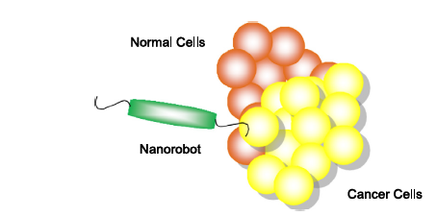
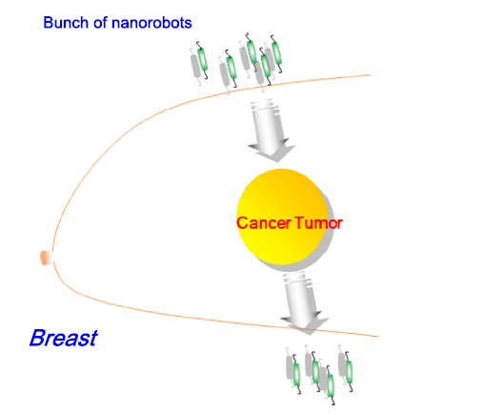
Nano Robotics and Automation in The Radiation Field(Conceptual).
The Cons:
For a 1cm mass the robots can only treat 5nm linear tissue surface area per pass.
Potential for the patient’s body to reject treatment.
While collision avoidance is proposed, it’s not guaranteed all nanobots from treatments will be recovered.
The Pros:
Fully autonomous micro drone robots roughly the size of a singe molecule.
Carries a discrete radioactive isotope as a payload to the cancerous mass.
Would reduce treatment times.
Nanobot tech could be used in industrial practice for diagnostics or repairs.

Slide 6
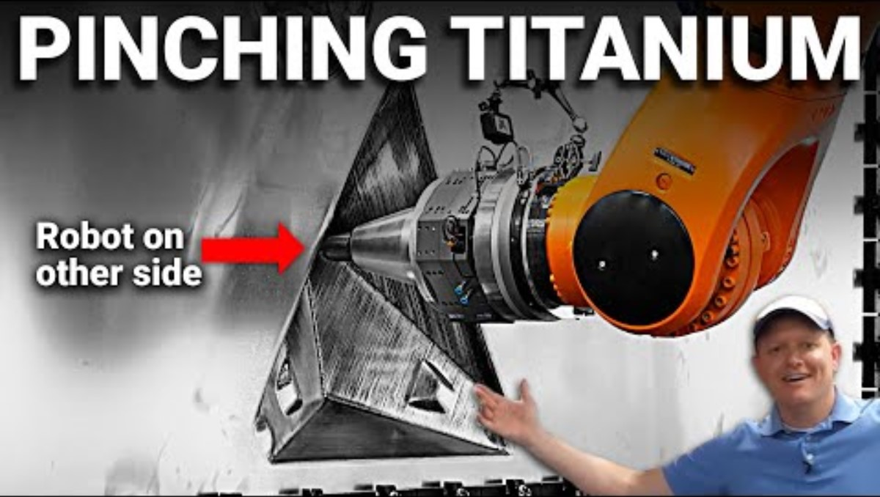
Robotic Incremental Sheet Forming(aka: Robo-Forming)
The Pros:
Robot Agnostic Implementation of software.
KUKA and FANUC robots are programmed to run the same routines.
Increased safety for the operators.
Can create complex geometry as products.
VS.
The Cons:
Slower processing time than manual labor method .
Some products may not require the level of complexity ISF can output for small or repetitive parts.

Slide 7
Discussion
Which Projects seem the most viable to improve previous industry practices?
Incremental Sheet Forming
Smart Factory SMS-DT’s For Performance and Security
Automotive DT’s for prototype testing and modeling of green energy vehicles.
Nanorobotics(very cool, but still feels like it is something for the future).

Slide 8
Questions?

